Slide 1

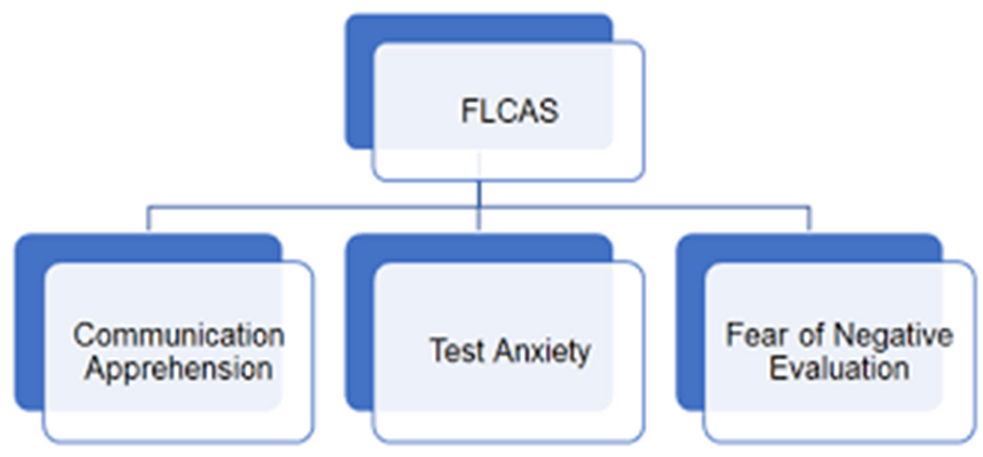
Thriving or Surviving: Motivation and Anxiety in the Foreign Language Classroom
Isabelle Girolamo- EDUC 420- Diana Baker
INTRODUCTION
MATERIALS AND METHODS
Foreign Language Anxiety Scale
Motivation and anxiety are important aspects of foreign language learning. During my student teaching semester, I will explore the impacts of teaching methods that promote personal and cultural connection to the content of the course on student motivations and anxiety in the foreign language classroom.
Participants & Data Collection:
To understand the effects of the instructional practices, the study will collect both qualitative and quantitative data throughout the study period (about 7 weeks). The research will involve one class period, with participation from a group of students (aiming for 3–5 participants). Student participation is voluntary, and multiple methods will be used to capture their experiences and changes over time.
Qualitative Methods:
Teacher Observations and Field Notes:
Weekly notes and classroom observations will be recorded to document student interactions, behaviors, and responses to instruction. These notes will be used to determine shifts in classroom engagement and anxiety.
Biweekly Student Reflections:
Every two weeks, students will be asked to complete a written reflection during class about their experiences in the class. These reflections provide insight into students’ motivation, engagement, and anxiety regarding the lessons in class.
Quantitative Methods:
Surveys:
At the beginning and end of the semester, students will complete the Foreign Language Classroom Anxiety Scale (Horwitz et al., 1986), delivered through an online form. Additional researcher-created questions will address student motivation. This will help identify changes over time in their anxiety and motivation related foreign language learning.
In your own experiences learning a foreign language, what moments made you feel most anxious, and how might those relate to what the FLAS measures?
RESEARCH QUESTION
RESULTS
How can student motivation be increased and anxiety decreased in the foreign language classroom?
The data collected will be used to evaluate student sentiments about their time in the foreign language classroom receiving culturally and personally relevant language instruction. I will analyze the data to determine if there has been a significant change in student anxiety levels over the course of the study as new teaching methods have been implemented.
FOREIGN LANGUAGE ANXIETY SCALE MEASUREMENTS
REFERENCES
Bhuana, G. P. (2017). Language learning motivation among senior high school students. Acuity : Journal of English Language Pedagogy, Literature and Culture, 2(2), 57–63. https://doi.org/10.35974/acuity.v2i2.616
Horwitz, E. K., Horwitz, M. B., & Cope, J. (1986). Foreign language classroom anxiety. The Modern Language Journal, 70(2), 125–132. https://doi.org/10.2307/327317

