Slide 1

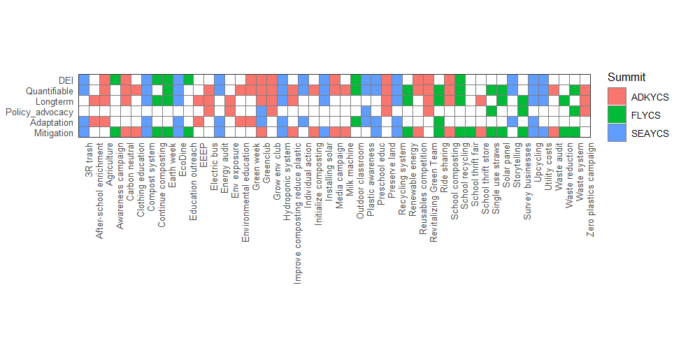
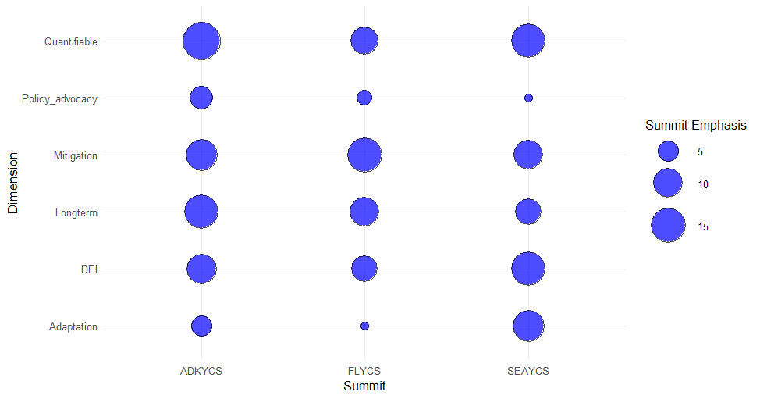
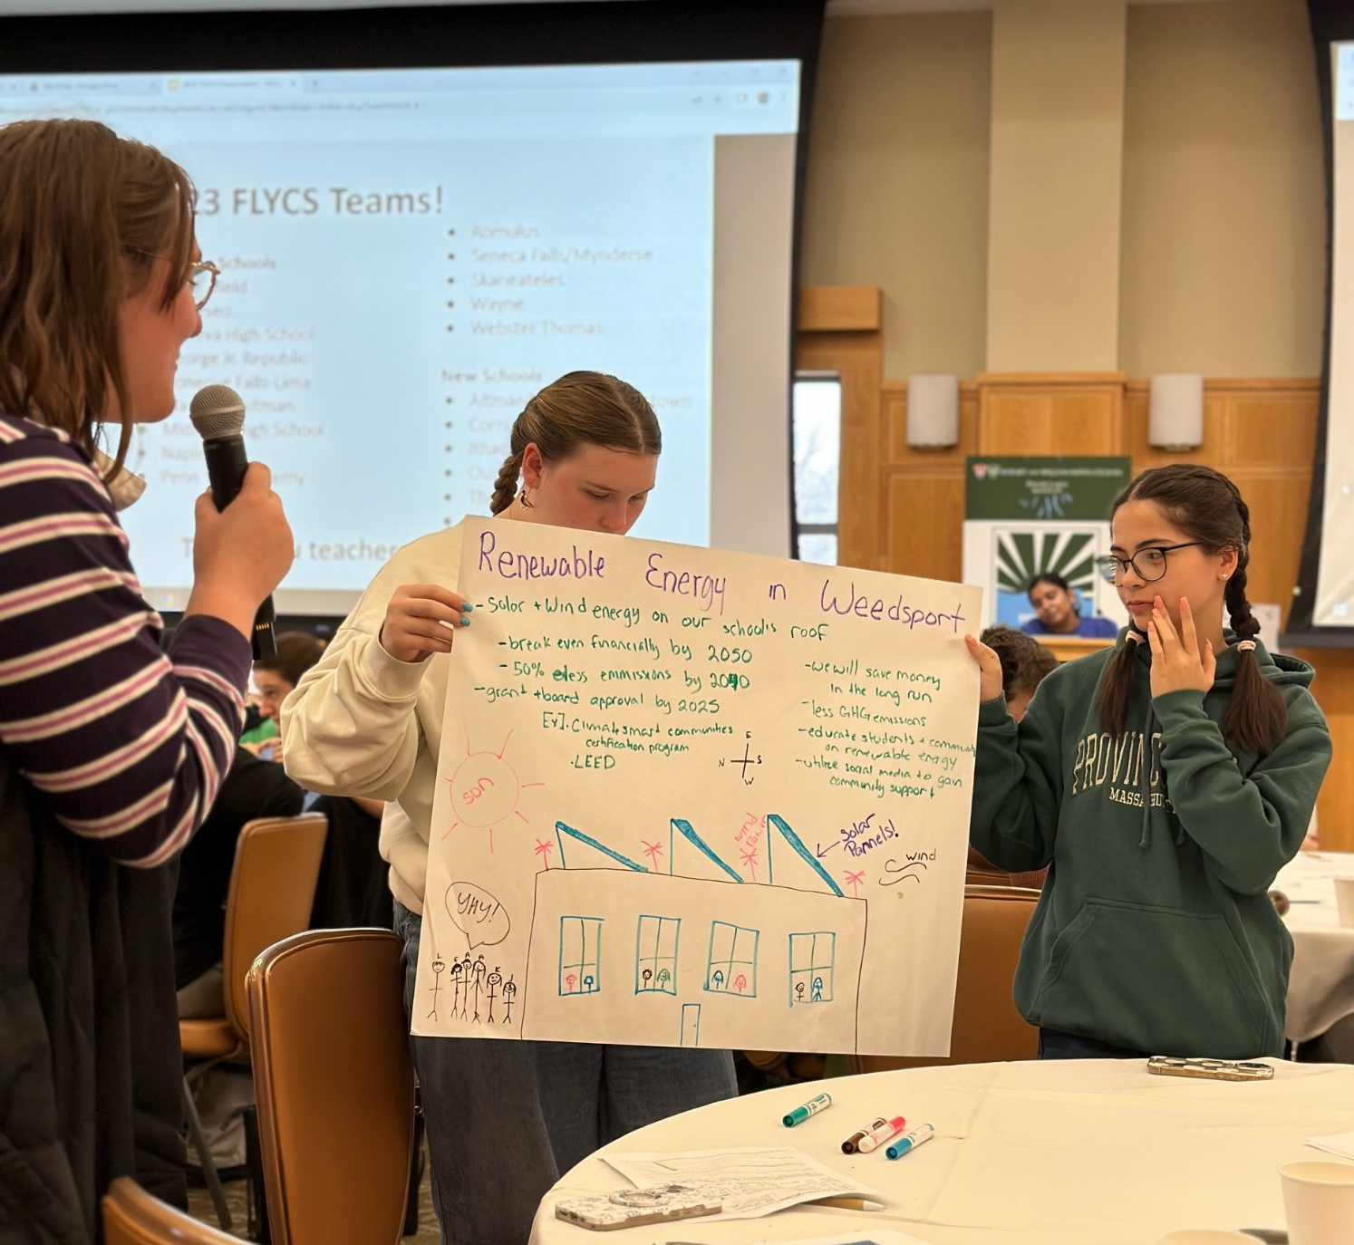
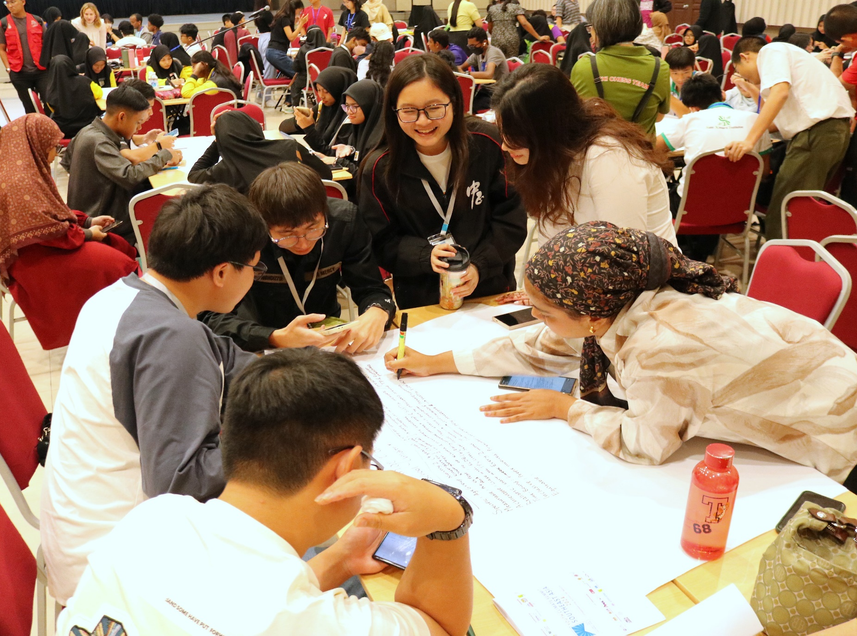
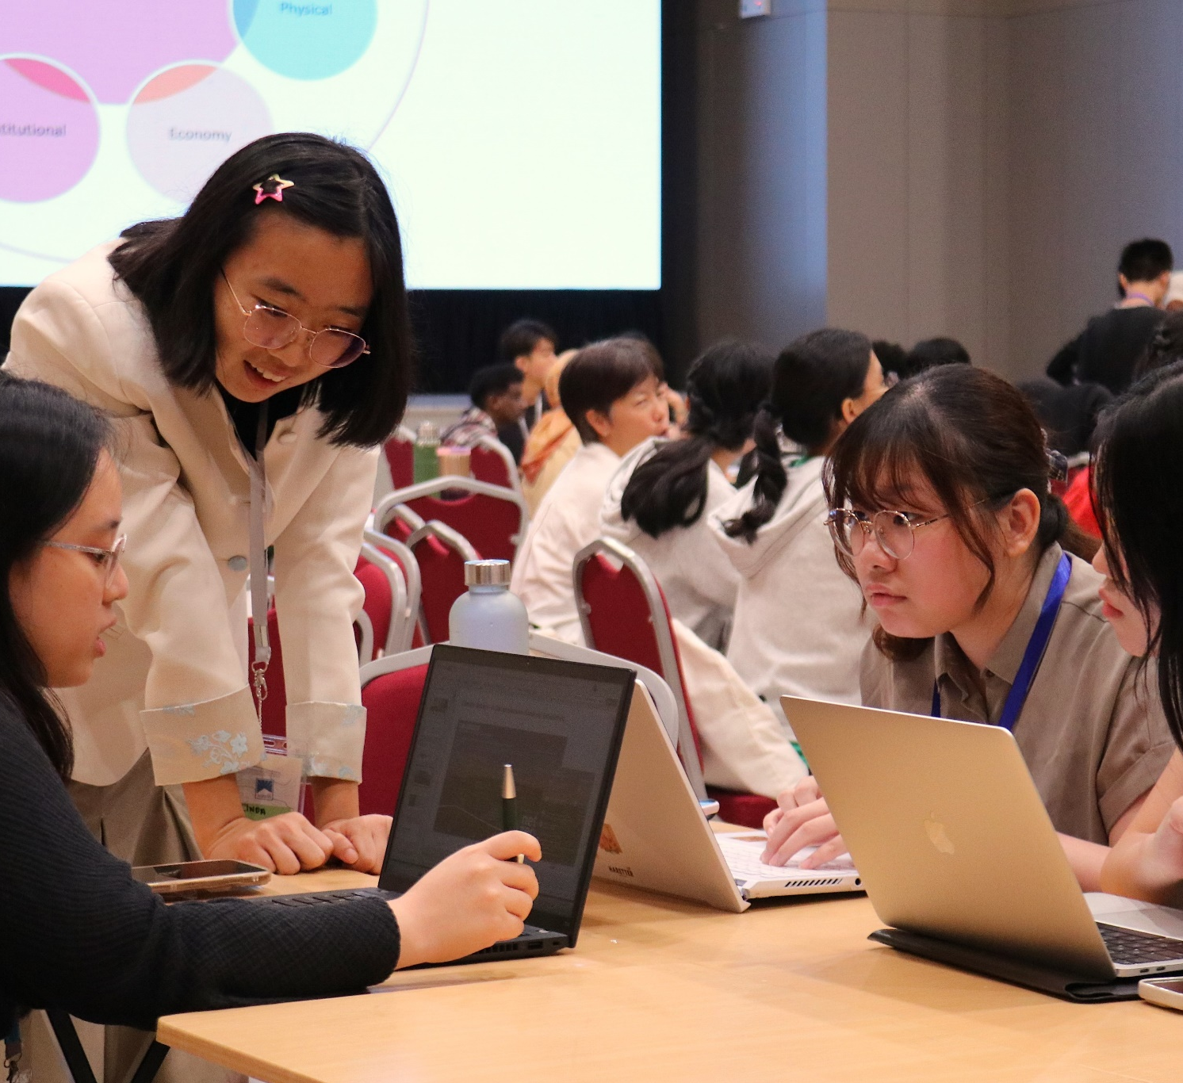
From Awareness to Action: A Comparative study of Youth-Driven
Climate Action Plans Across Youth Climate Summits
Anjalee Wanduragala ‘25, Professor of Environmental Studies Kristen Brubaker
Introduction
Discussion and Conclusions
Young people play a critical role in addressing climate change, not only as future leaders but as active participants in shaping solutions today. Movements like Fridays for Future show how youth are driving global conversations on climate justice and sustainability. Yet, barriers such as limited access to decision-making, financial constraints, and tokenism often hinder their impact.
Youth Climate Summits (YCS) help bridge this gap by equipping young people with skills, networks, and platforms to create Climate Action Plans (CAPs) tailored to their communities. The YCS model, developed by The Wild Center, has been replicated globally to foster youth-led climate solutions.
This study analyzes CAPs from three summits—Southeast Asian (SEAYCS), Adirondack (ADKYCS), and Finger Lakes (FLYCS)—to explore:
1. Focus on mitigation, adaptation, or policy advocacy
2. Integration of diversity, equity, and inclusion (DEI)
3. Timeline (Short-term vs. long-term)
4. Collaborative partnerships
5. Quantifiable goals
6. Challenges in implementation
By examining how youth frame climate solutions, this research offers insights into their priorities and the influence of the YCS model.
Youth Climate Summits (YCS) reflect how local contexts shape climate priorities. The results highlight the influence of regional vulnerabilities and lived experiences. While youth demonstrated strategic thinking across all regions, a lack of focus on policy advocacy indicates an opportunity to better support youth in engaging with civic and institutional systems.
Looking ahead, strengthening the Youth Climate Summit model with civic engagement tools—like policy training and decision-maker access—can bridge current gaps. Cross-summit collaboration could also enhance strategies by combining local and global perspectives. Future research should track the long-term impact of Climate Action Plans (CAPs), while centering equity frameworks will ensure DEI is integral, not optional. With the right support, youth aren’t just preparing to lead—they already are.
Figure 1. Presence absence plot showing variables across CAPS in the three summits .
Tests and results
Figure 1 (Presence/Absence Matrix):
CAPs were evaluated for six dimensions:
Mitigation, Adaptation, Policy Advocacy, Long-term Planning, Quantifiable Goals, and DEI.
Mitigation was the most consistently present dimension across all summits.
Common actions included: waste reduction, composting, renewable energy, and school-based sustainability.
SEAYCS (South Asia):
Strong emphasis on Adaptation and DEI.
Addressed resilience, inclusion of marginalized and wider communities.
FLYCS (Finger Lakes):
Focused mainly on Mitigation and short-term actions.
Lower presence of Adaptation and DEI.
ADKYCS (Adirondacks):
Balanced presence across all dimensions.
High focus on Quantifiable Goals and Long-term Planning.
2. Figure 2 (Emphasis Plot):
Quantifiable Goals were most emphasized in ADKYCS → Reflects priority on measurable impact.
Mitigation was a top priority across all summits, especially in FLYCS and SEAYCS.
Adaptation and DEI were strongly emphasized in SEAYCS → Tied to regional vulnerabilities and equity issues.
Policy Advocacy was the least emphasized overall, particularly in FLYCS and SEAYCS → Indicates limited civic engagement.
3. Overall Summary:
All summits support youth-led climate action, but regional trends differ:
U.S. Summits (ADKYCS & FLYCS): Focus on tangible, school-based mitigation strategies.
SEAYCS: Greater emphasis on adaptation, equity, and systemic change.
Figure 2. Emphasis plot showing which variables were most emphasized in each summit
Methodology
References
This study uses a comparative qualitative content analysis of Climate Action Plans (CAPs) developed at three Youth Climate Summits: the Finger Lakes and Adirondack Summits in the U.S., and the South Asia Youth Climate Summit in Malaysia. CAPs were analyzed using a matrix to identify patterns, themes, and regional differences based on the following criteria:
Type of Climate Action – Categorized as:
Mitigation (e.g., emissions reduction, composting),
Adaptation (e.g., disaster preparedness, education),
Policy Advocacy (e.g., institutional change efforts).
Plans could fall into multiple categories.
DEI Considerations – Assessed for references to diversity, equity, inclusion, marginalized communities, Indigenous knowledge, or broad community engagement.
Timeline – Classified as: Short-term (within one school year), or Long-term (multi-year efforts or sustained partnerships).
Collaboration – Identified based on partnerships with schools, government agencies, community stakeholders, or external organizations.
Quantifiable Goals – Evaluated for inclusion of measurable targets (e.g., “reduce plastic use by 50%”).
Challenges – Derived from post-summit surveys and grant reflections, highlighting barriers such as funding, support, or sustaining engagement.
Kosciulek, D. (2020). Strengthening Youth Participation in Climate-Related Policymaking. South African Institute of International Affairs. http://www.jstor.org/stable/resrep28260
de Moor, J., De Vydt, M., Uba, K., & Wahlström, M. (2020). New kids on the block: taking stock of the recent cycle of climate activism. Social Movement Studies, 20(5), 619–625. https://doi.org/10.1080/14742837.2020.1836617
Boulianne, S., Lalancette, M., & Ilkiw, D. (2020). “School Strike 4 Climate”: Social Media and the International Youth Protest on Climate Change. Media and Communication, 8(2), 208-218. https://doi.org/10.17645/mac.v8i2.2768
YOUNGO. (2023c). Youth stocktake of UNFCCC Processes. https://unfccc.int/sites/default/files/resource/YOUTH%20STOCKTAKE%20on%20UNFCCC%20PROCESSES%208%2012%2023.pdf
Kretser, J., & Griffin, E. (2020). Taking back our future: Empowering youth through climate summits. In Teaching climate change in the United States (pp. 143-152). Routledge.
The Wild Center. (n.d.). Youth Climate Program. https://www.wildcenter.org/our-work/youth-climate-program/
Acknowledgments
Special thanks to Nadia from the Finger Lakes Institute, and Jen and Cedar from the Wild Center for helping me with sharing their CAPs from the summits. I appreciate Moira who assisted with converting my data into visuals. Thank you, Professor Mauer for helping Professor Brubaker and I through this research process. Finally, a shout-out to the photographers that captured these images from the summits.
Figure 3, 4 & 5. Young participants at summits preparing and presenting their CAPs

