Slide 1
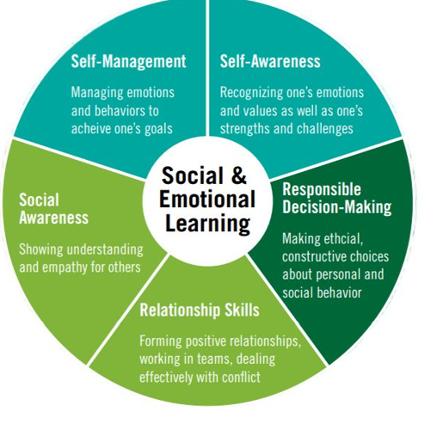
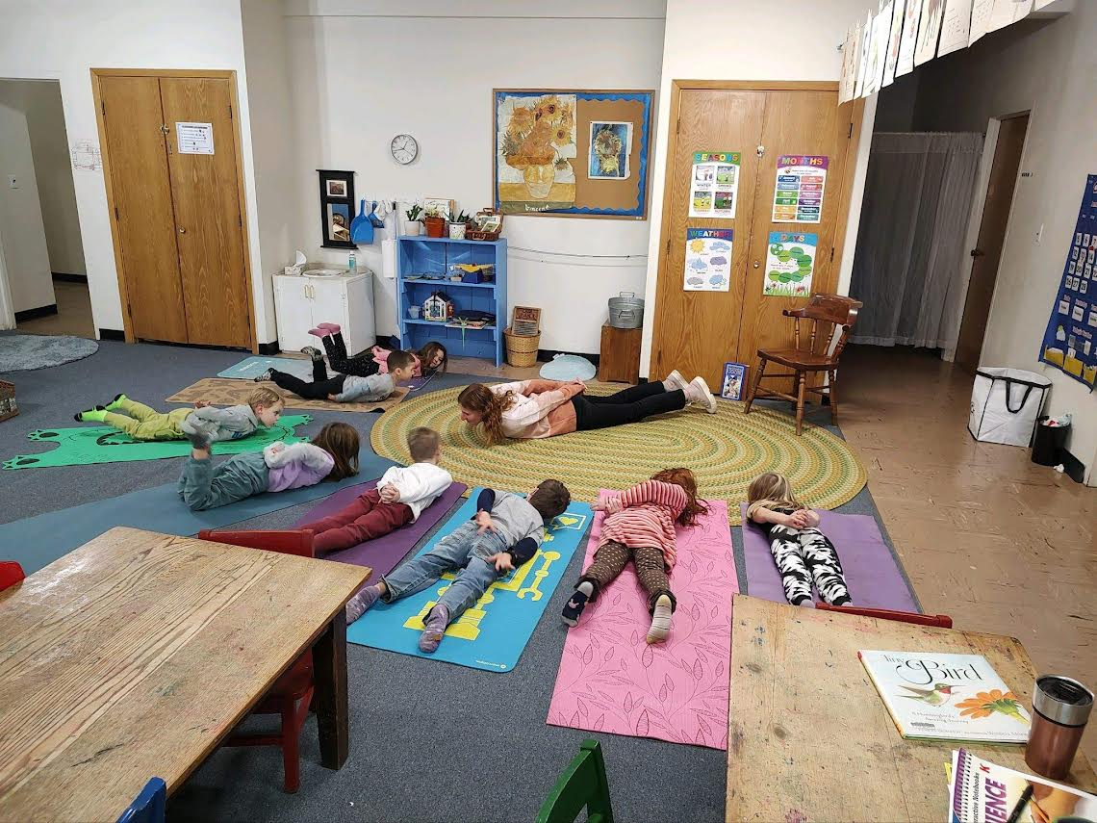
Integration of Social Emotional Learning (SEL) in an Elementary Classroom
Rebecca Barr
Background:
It is important to teach SEL
→ the skills taught in SEL help
students develop healthy
relationships, improve students’
academic, mental health, and
behavioral outcomes and positively
impact classroom climate and
teaching practices
SEL skills are always needed
but these are skills that are learned
Context:
Students in my student teaching
placement which is a fifth grade
integrated co-taught classroom in
Geneva
Purpose:
Oftentimes SEL is embedded into an ELA lesson or situational. Those are important times for SEL to be used but research suggests that SEL is more effective when it is incorporated into the classroom across multiple subjects.
The goal of this practitioner inquiry is to find and learn more about methods/ strategies that are used to incorporate SEL into the classroom daily more than just in certain situations that lead to an SEL lesson.
Methods:
Teacher interviews
→ understanding how teachers integrate and understand SEL
→ the researcher aims to gather detailed responses from the questions asked
Student check-ins
→ focus on student learning and thinking in regard to SEL
Student work and artifacts
→ understand how students are learning SEL and to figure out which teaching methods are working or not
→ work from SEL lessons and group activities
Student check-ins and student work/artifacts = regular teaching practices and will in no way alter students' participation in typical instruction
Sources:
Bailey, R., Stickle, L., Brion-Meisels, G., & Jones, S. M. (2019). Re-imagining
social-emotional learning: Findings from a strategy-based approach. The Phi Delta Kappan, 100(5), 53–58. https://www.jstor.org/stable/26614883
Civic Enterprises . (2013). The missing piece. A REPORT FOR CASEL.https://casel.org/the-missing-piece/?view=true
Dana, N. F., and Yendol-Hoppey, D. (2020). The Reflective Educator’s Guide to Classroom
Research: Learning to Teach and Teaching to Learn through Practitioner Inquiry, 4th ed. Thousand Oaks, CA: Corwin ISBN 978-1-5443-5218-3 (bookstore, library reserve)

